Slide 1







THANK YOU FOR DOWNLOADING!
In case the embedded fonts don’t work, here are the download links:
VT323
https://fonts.google.com/specimen/VT323
Roboto Condensed
https://fonts.google.com/specimen/Roboto+Condensed
@dstoryco
www.dstory.co
This is also an interactive navigation bar that looks like a music player. Copy and paste it to the bottom of your slides:
Simple ver:
5:00
Spotify ver:
GHOSTING
2:00
5:00
TXT
Previous / Next slide
Current slide number
Move the indicator to the right for each slide
Total number of slides
Go to the summary slide

Slide 2
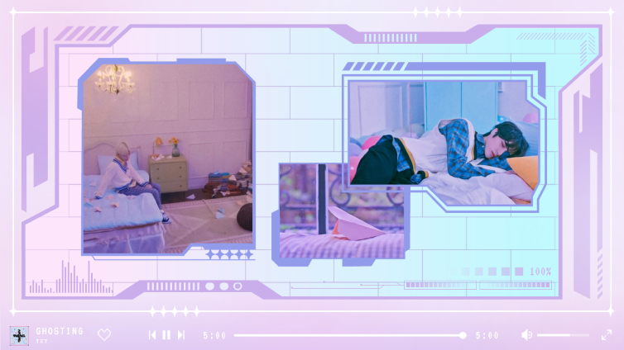
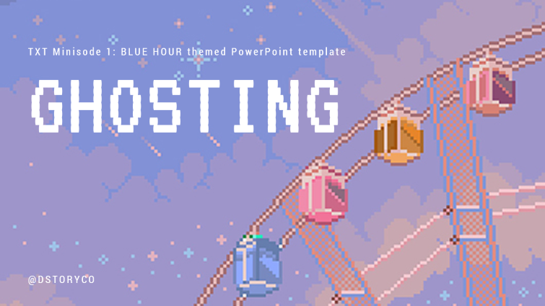
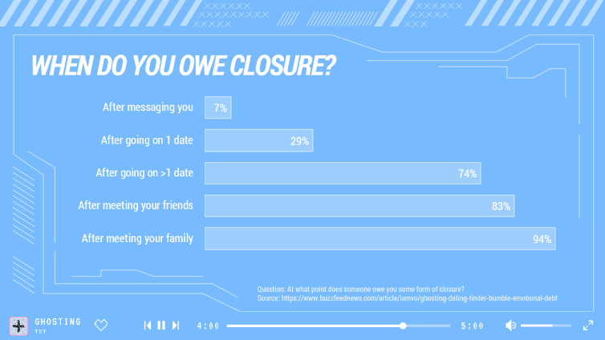
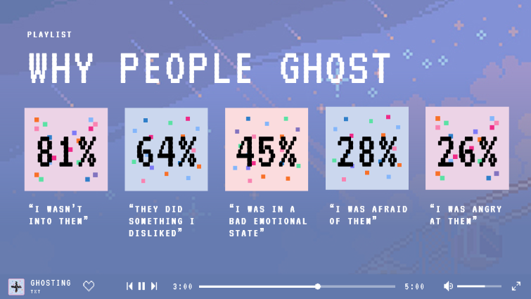
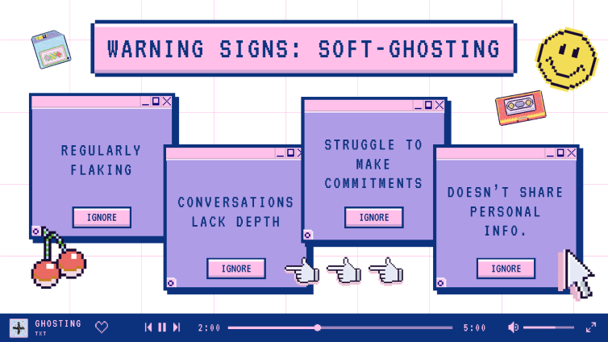
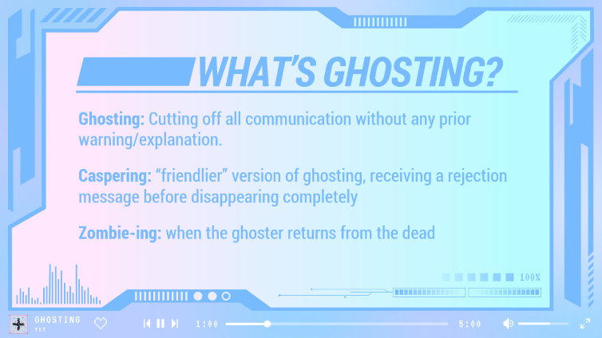
SUMMARY

Slide 3

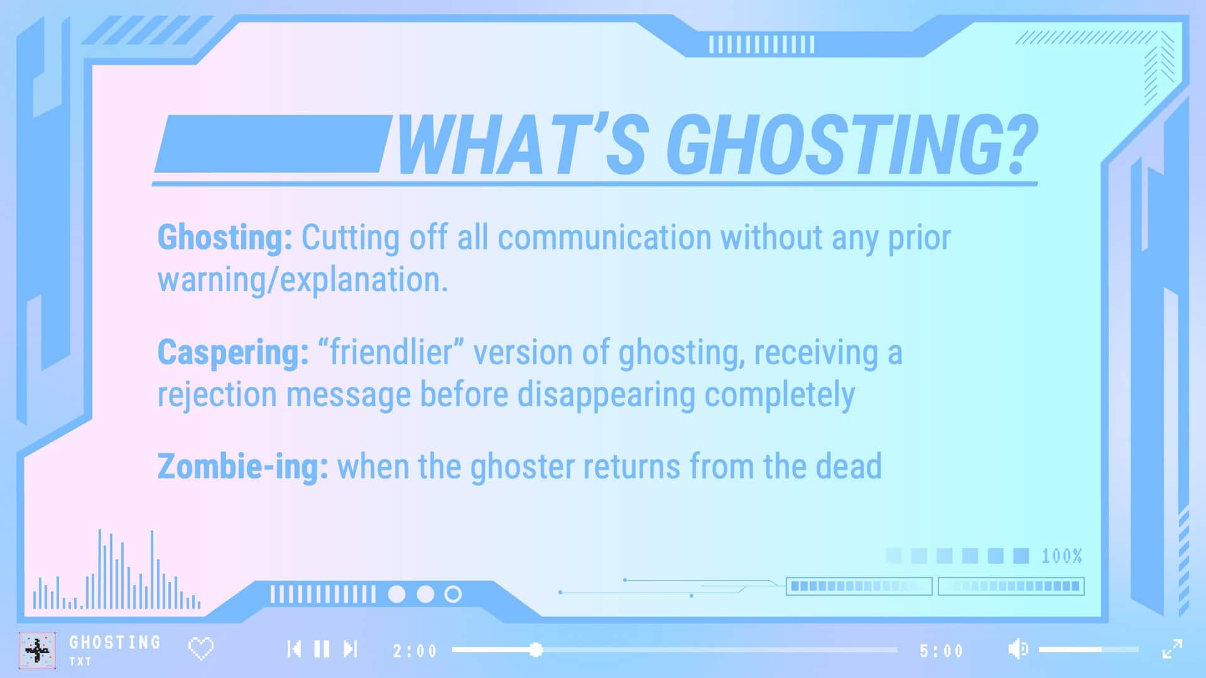
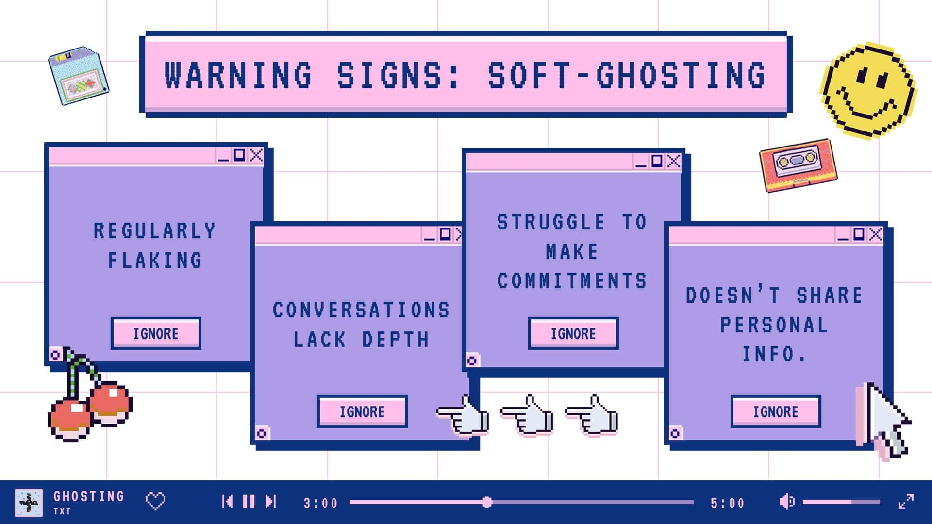
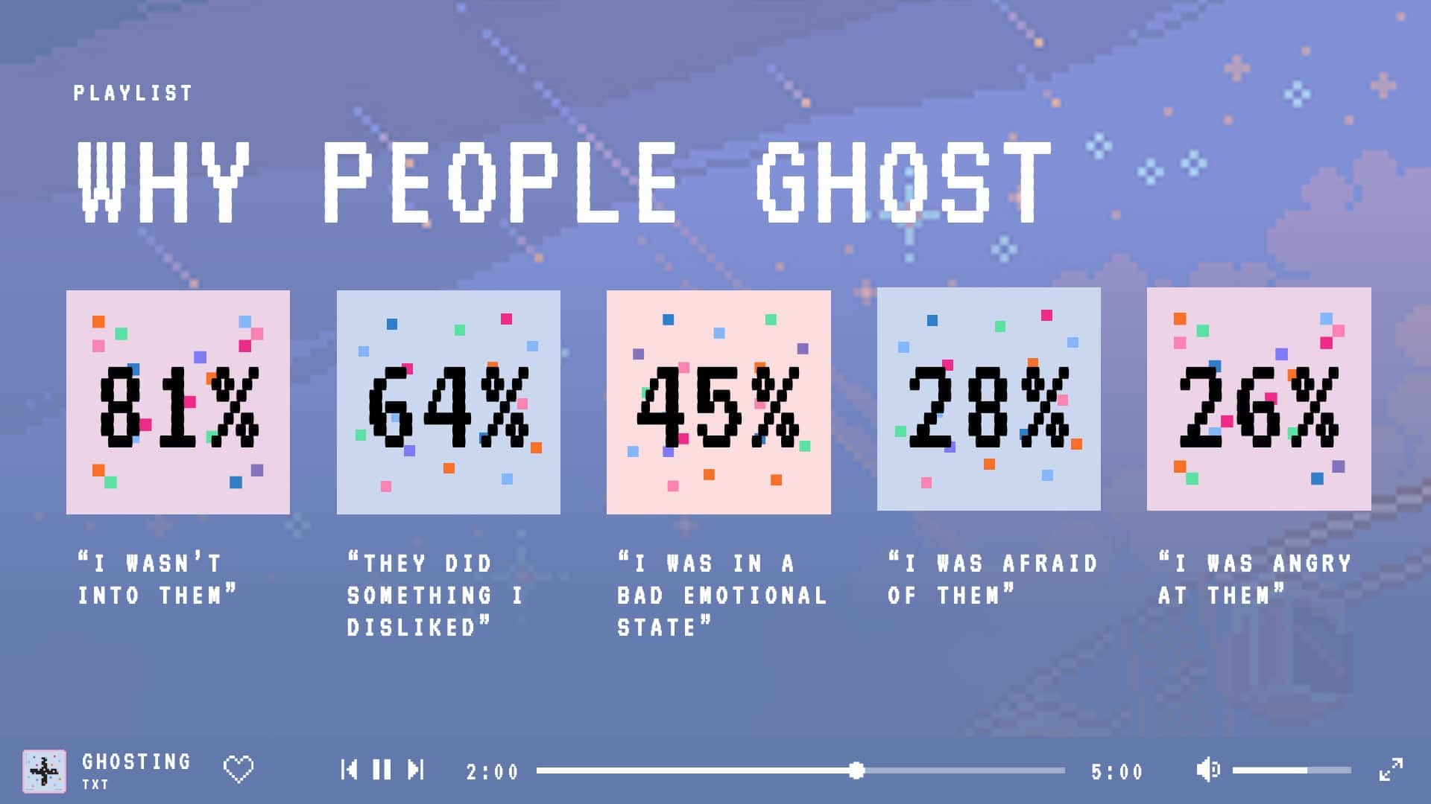
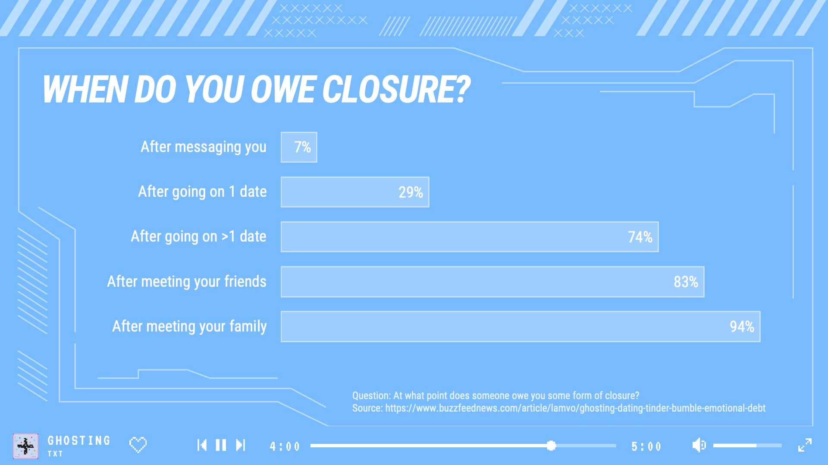

OVERVIEW BACKUP

Slide 4
GHOSTING
TXT Minisode 1: BLUE HOUR themed PowerPoint template
@DSTORYCO

Slide 5







03:04
1
2
ABC
3
DEF
4
GHI
5
JKL
6
MNO
7
PQRS
8
TUV
9
WXYZ
0

Slide 6
WHAT’S GHOSTING?
Ghosting: Cutting off all communication without any prior warning/explanation.
Caspering: “friendlier” version of ghosting, receiving a rejection message before disappearing completely
Zombie-ing: when the ghoster returns from the dead
GHOSTING
1:00
5:00
TXT

Slide 7













WARNING SIGNS: SOFT-GHOSTING
REGULARLY FLAKING
STRUGGLE TO MAKE COMMITMENTS
CONVERSATIONS LACK DEPTH
DOESN’T SHARE PERSONAL INFO.
IGNORE
IGNORE
IGNORE
IGNORE
GHOSTING
2:00
5:00
TXT

Slide 8


WHY PEOPLE GHOST
PLAYLIST
81%
64%
45%
28%
26%
“I WASN’T INTO THEM”
“THEY DID SOMETHING I DISLIKED”
“I WAS IN A BAD EMOTIONAL STATE”
“I WAS AFRAID OF THEM”
“I WAS ANGRY AT THEM”
GHOSTING
3:00
5:00
TXT

Slide 9
WHEN DO YOU OWE CLOSURE?
Question: At what point does someone owe you some form of closure? Source: https://www.buzzfeednews.com/article/lamvo/ghosting-dating-tinder-bumble-emotional-debt
GHOSTING
4:00
5:00
TXT

Slide 10


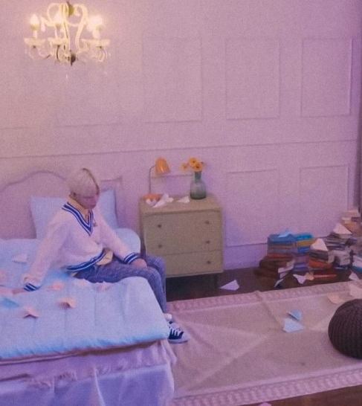
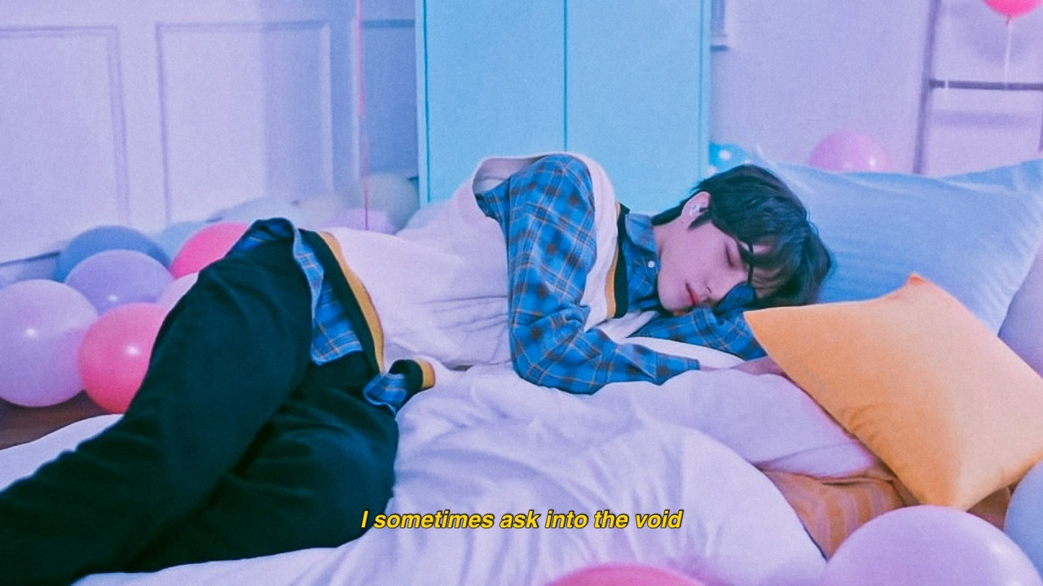

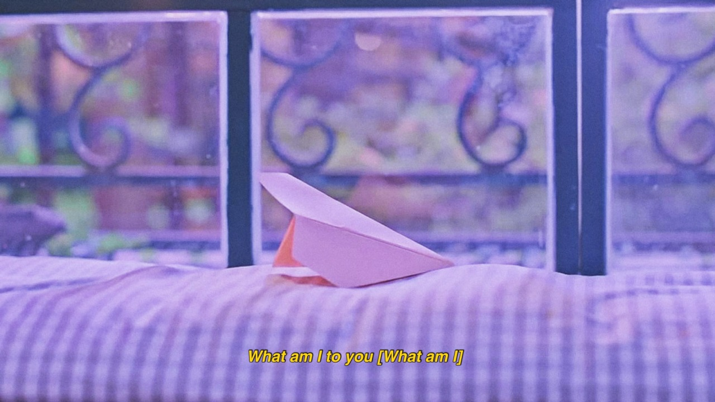
GHOSTING
5:00
5:00
TXT

